Slide 1
Report on ‘DeltaCode’
Project Management
Presentation
To be Presented by Zain Khalid (FA19-BCS-112) & Zohaib Mehmood (FA19-BCS-087)

Slide 2
Project analysis slide 2
Report’s Content
4. Planning
1. Project Description
DeltaCode PROJECT
5. Budgeting
2. Report Method
6. Changings
3. Initiation

Slide 3

Project analysis slide 3
Project Description
“As part of Acceleron Corp.’s mission to solve intelligence, we want you to develop a system called “DeltaCode” that writes computer programs at a competitive level.”

Slide 4
Project analysis slide 3
Report Methodology
This report strictly adhere to the methodology instructed through the example 3.11 and chapter 3 of “Introduction to software project management” by Adolfo Villafiorita.

Slide 5
Project analysis slide 3
Report Methodology
Changing the plan to meet external Deadline
Initiating
Building a Plan
Creating a Budget for the Project
Title
Scope Document
Identify Team Requirements
Obtain Authorization
Development Model
Gant Chart
Deliverables from the Client
Cost of Resources
Budget Estimation for the Project
Changing the project approach
Reducing or changing the project scope
Allocating resources more efficiently
Fast tracking.

Slide 6
Project analysis slide 3
Initiating
Title : DeltaCode
Scope Document

Slide 7
Project analysis slide 3
Initiating
Scope Document
Major Stake Holders
Zed Developers
Acceleron Corps

Slide 8
Project analysis slide 3
Initiating
Scope Document
Goals
Experimental Application.
Deep Learning Algorithm.
Competitive Code Output.

Slide 9
Project analysis slide 3
Initiating
Scope Document
Total Budget
100,000$

Slide 10
Project analysis slide 3
Initiating
Scope Document
Project TimeLine
Begin : 22– June – 2022
Deliver by : 8-July-2023

Slide 11
Project analysis slide 3
Initiating
Scope Document
Deliverables
Scope Document
Project Plan (Gantt Chart)
Budget Distribution List
Progress Report
Test Reports

Slide 12
Project analysis slide 3
Initiating
Scope Document
Constraints
Hyper Complexity.
Processing Power Limitation.
Difficulty In recognizing intent of Statements.

Slide 13
Project analysis slide 3
Initiating
Scope Document
Risks
Crashing due to buffer overload.
Miss-identification of Variables.
Input not identifiable.
Limitation of algorithm.

Slide 14
Project analysis slide 3
Initiating
Requirements of the development team
TPU enabled Work Station
Deep Learning Concepts
Algorithm Design Concepts
NLP Expert

Slide 15
Project analysis slide 3
Initiating
Requirements of the development team
Request for Project Manager : Allah Deta
Request has been granted by the performing organization body.

Slide 16
Project analysis slide 3
Initiating
Authorization:
In light of the scope document,
The Client “Acceleron Corps.” has authorized to began work.
The performing organization “Zed Developers” has authorized to began work.

Slide 17
Project analysis slide 3
Building a Plan
Development Model
Water Fall

Slide 18
Project analysis slide 3
Building a Plan
For the whole lifetime of the project;
It has been divided into 4 work packages.
WP1. Inception
WP2. Construction
WP3. Deployment
WP4. Experimentation

Slide 19
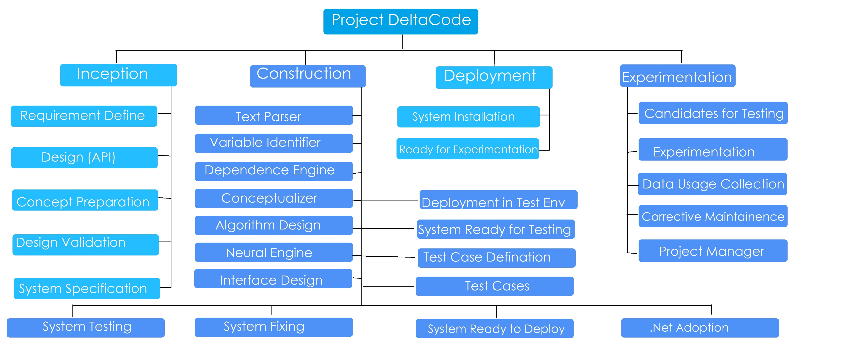
Project analysis slide 3
Building a Plan
Work Breakdown Structure

Slide 20
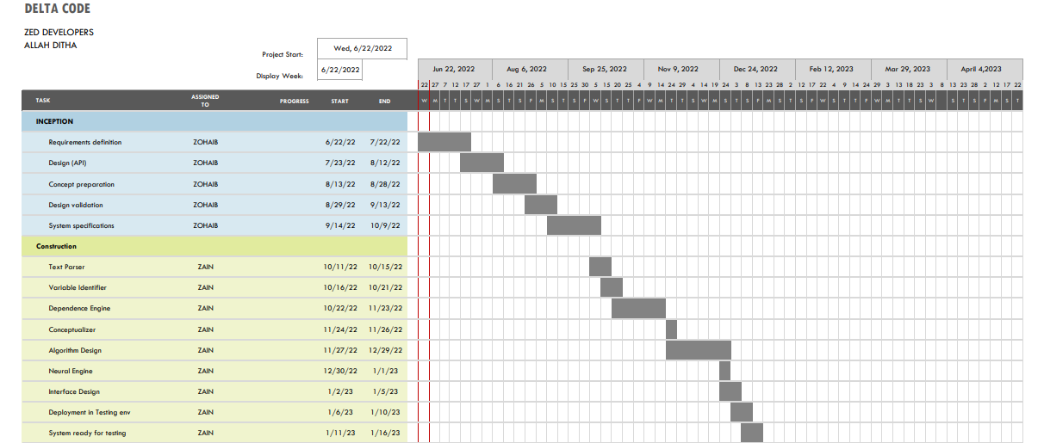
Project analysis slide 3
Building a Plan
Gantt Chart

Slide 21
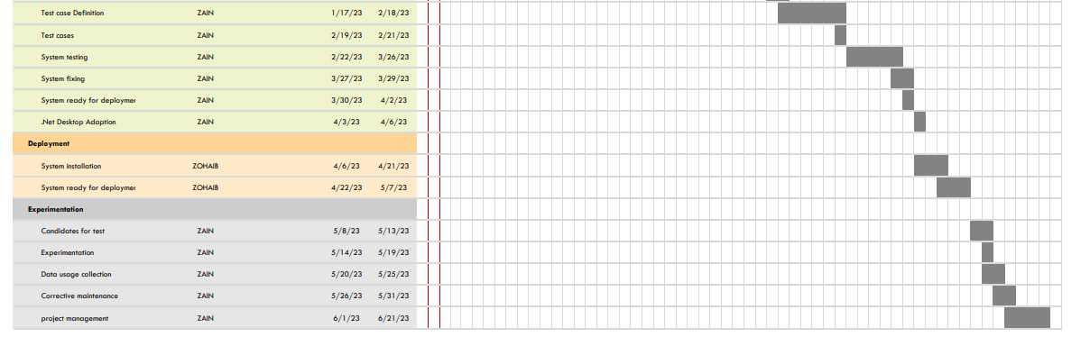
Project analysis slide 3
Building a Plan
Gantt Chart

Slide 22
Project analysis slide 3
Building a Plan
Deliverable from Client
List of candidates for WP4
Acquisition Head
Adolf Hitler
IT Advisor
John Wick

Slide 23
Project analysis slide 3
Creating a Budget
Cost of Resources
Budget Estimation

Slide 24
Project analysis slide 3
Creating a Budget
Cost of Resources
Name | Type | Maximum Availability % | Cost ($/h) | Overtime ($/h) | Accrue
R1. Requirement Specialist | Work | 100% | 40 | 60 | Prorated
R2. System Architect | Work | 100% | 40 | 60 | Prorated
R3. Developer | Work | 100% | 40 | 60 | Prorated
R4. Developer | Work | 100% | 40 | 60 | Prorated
R5. NLP Expert | Work | 100% | 40 | 60 | Prorated
R6. Tester | Work | 100% | 50 | 100 | Prorated
PM. Project Manager | Work | 100% | 60 | 100 | Prorated
R7. Researcher | Advice | 100% | 60 | 100 | Prorated
R8. TPUs | Equipment | 100% | 25 | 50 | Prorated

Slide 25
Project analysis slide 3
Creating a Budget
Task Name | Resource Name | Work ( Days) | Cost
Project |  | 445 | 70,000$
Inception |  | 120 | 10,000$
Requirements Definition | R1. Requirements Specialist | 20 | 2000$
Design (API) | R2. System Architect | 10 | 4000$
Concept Preparation | R7. Designer | 30 | 1000$
Design Validation | R1. Requirements Specialist | 20 | 1000$
System Specifications | R2. System Architect | 40 | 2000%
Construction |  | 250 | 40,000$
Text Parser | R3. Developer | 10 | 8000$
Variable Identifier | R3. Developer | 20 | 2000$
Dependence Engine | R3. Developer | 50 | 4000$
Conceptualizer | R4. Developer | 30 | 5000$
Budget Estimation

Slide 26
Project analysis slide 3
Creating a Budget
Task Name | Resource Name | Work (IN Days) | Cost
Algorithm Design | R4. NLP Expert | 8 | 1000$
Neural Engine | R4. Developer | 30 | 10,000$
Interface Engine | R5. Developer | 10 | 7000$
.NET Desktop Adaptation | R7. Developer | 15 | 3000$
Deployment in Testing Env | R3. Developer | 2 | 500$
Design Validation |  | 15 | 200$
System Ready for Testing |  | 5 | 50$
Test Case Definition | R6. Tester | 2 | 1000$
Test Cases | R6. Tester | 3 | 1500$
System Testing | R6. Tester | 6 | 1000$
System Fixing | R3. Developer | 3 | 2400$
System Ready for Deployment |  | 1 | 50$

Slide 27
Project analysis slide 3
Creating a Budget
Task | Resource Allocation | Work (In Days) | Cost
Deployment |  | 75 | 20,000$
System Installation | R2. Developer | 5 | 2000$
System Ready for Experimentation |  | 1 | 500$
Experimentation | R7. Developer | 50 | 2000$
Candidates for Test |  | 4 | 7000$
Experimentation |  | 10 | 1000$
Corrective Maintenance | R5. Developer | 6 | 500$
Project Management | PM Project Manager | 4 | 1500%

Slide 28
Project analysis slide 3
Changing plan to meet deadline
For the given plan we are 1 month late.

Slide 29
Project analysis slide 3
Changing plan to meet deadline
To meet deadline we have 2 options
Changing the Project Approach
Fast Tracking

Slide 30
Project analysis slide 3
Changing plan to meet deadline
We have decided to Change the Project Approach
Make three contracts
Initiation
Construction
Deployment and Experimentation

Slide 31
Project analysis slide 3
Changing plan to meet deadline
We have decided to Change the Project Approach
Parallel Model of Development

Slide 32
Project analysis slide 3
Changing plan to meet deadline
Fast Tracking
Start Testing each module in construction package after it’s completion.

Slide 33
Thank You
Presented by Zain Khalid (FA19-BCS-112) and Zohaib Mehmood (FA19-BCS-087)

